Slide 1
Simplifying Fractions
EQ – How do we simplify fractions?
Mrs Stretch
Year 7

Slide 2
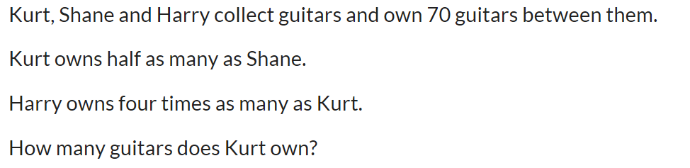
Simplifying Fractions
EQ – How do we simplify fractions?
Fraction = 26/50 Decimal = _________ Percentage = ________
Are the following fractions equivalent? 4/8 = 16/32
What is the area of a square 6 cm by 6 cm?
What is half of 1/4 ?

Slide 3
From Last Lesson
Consider the fraction $\frac{2}{5}$. If the numerator and denominator of the fraction are multiplied by 4, what happens to the:
number of pieces?
size of each piece?
size of the fraction?
Notes:
The 2 pieces become 8, which is four times greater.
The size of each piece becomes 4 times smaller.
The fraction 8/20 is the same size as the fraction 2/5.

Slide 4
From Last Lesson
Consider the fraction $\frac{15}{20}$. If the numerator and denominator of the fraction are divided by 5, what happens to the:
number of pieces?
size of each piece?
size of the fraction?
Notes:
The 15 pieces become 3, which is five times smaller.
The size of each piece becomes 5 times greater.
The fraction 15/20 is the same size as the fraction 3/4.

Slide 5
24
7
30
Simplifying Fractions
Date
EQ – How do we simplify fractions?
$$\frac{500}{1000} \frac{17}{51} \frac{36}{72}$$
Which fraction is not equivalent to one half? Explain your reasoning.
  $\frac{17}{51}$ is not equivalent to one half because 51 is not two times greater than 17.
How many fractions have the same value as one half? Explain your reasoning.
  There is an infinite number. Any fraction is equivalent to one half as long as the denominator is two times greater than the numerator.
Notes:
Explain that this is the multiplicative relationship between the numerator and denominator and can be used to identify fractions that are equivalent to one half.

Slide 6
Practice
$$\frac{1}{2}=\frac{7}{}=\frac{}{36}=\frac{24}{}=\frac{77}{}=\frac{}{704}=\frac{721}{}$$
How would you work out the missing numbers in this equation?
Notes:
As all these fractions are equivalent to one half, the denominator must be two times greater than the numerator.
If given the numerator, it must be multiplied by two to find the denominator.
If given the denominator, it must be divided by two to find the numerator.
Explain that the multiplicative comparison of the numerator and denominator can be used to quickly identify equivalent forms of other unit fractions.

Slide 7

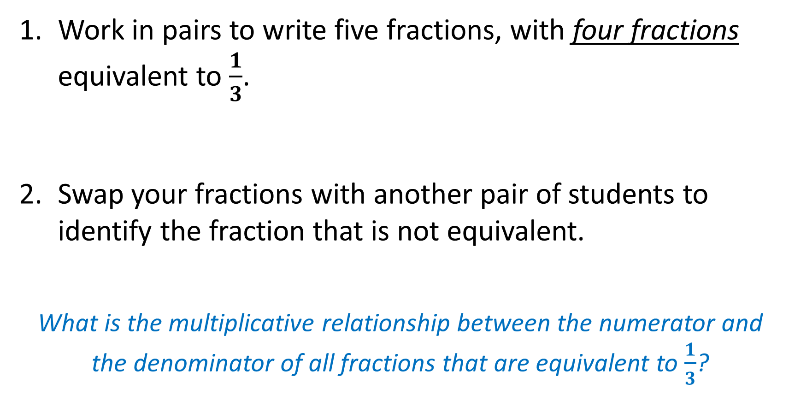
Task
Work in pairs to write five fractions, with four fractions equivalent to $\frac{1}{3}$.
Swap your fractions with another pair of students to identify the fraction that is not equivalent.
What is the multiplicative relationship between the numerator and the denominator of all fractions that are equivalent to $\frac{1}{3}$?
WICOR
Notes:
For all fractions equivalent to one third, the denominator must be three times greater than the numerator.

Slide 8


Slide 9
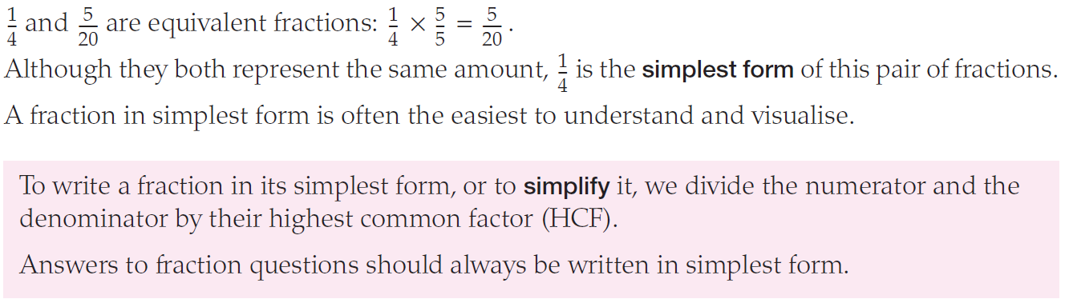
24
7
30
Simplifying Fractions
Date
EQ – How do we simplify fractions?
Notes:
Explain that this is the multiplicative relationship between the numerator and denominator and can be used to identify fractions that are equivalent to one half.

Slide 10
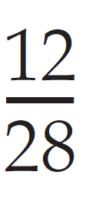
24
7
30
Simplifying Fractions
Date
EQ – How do we simplify fractions?
How can we simplify this fraction?
Notes:
Explain that this is the multiplicative relationship between the numerator and denominator and can be used to identify fractions that are equivalent to one half.

Slide 11
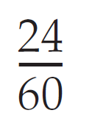
24
7
30
Simplifying Fractions
Date
EQ – How do we simplify fractions?
How can we simplify this fraction?
Notes:
Explain that this is the multiplicative relationship between the numerator and denominator and can be used to identify fractions that are equivalent to one half.

Slide 12
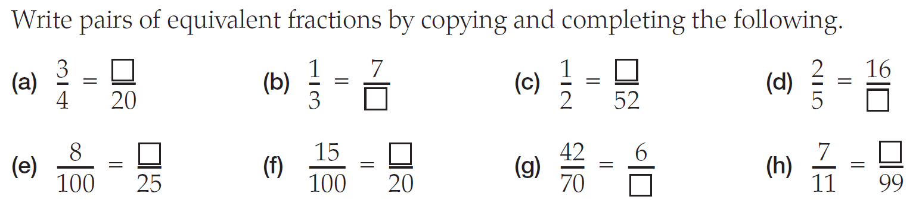

Slide 13
